Slide 1
Complex numbers for research software engineers
Pablo Rodríguez-Sánchez
Analytics SIG, 12/10/2020

Slide 2
Compute (transitive verb)
com·​pute | \ kəm-ˈpyüt
: to determine especially by mathematical means
// Compute the area of the triangle.
also : to determine or calculate by means of a computer
// Computing pi to over one billion places.

Slide 3
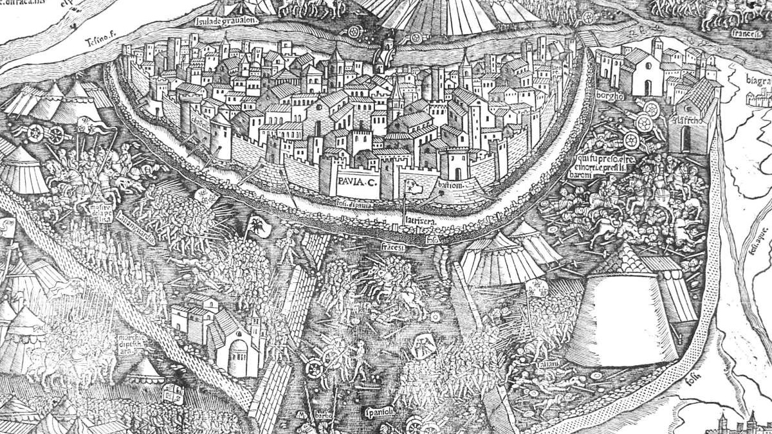

Slide 4
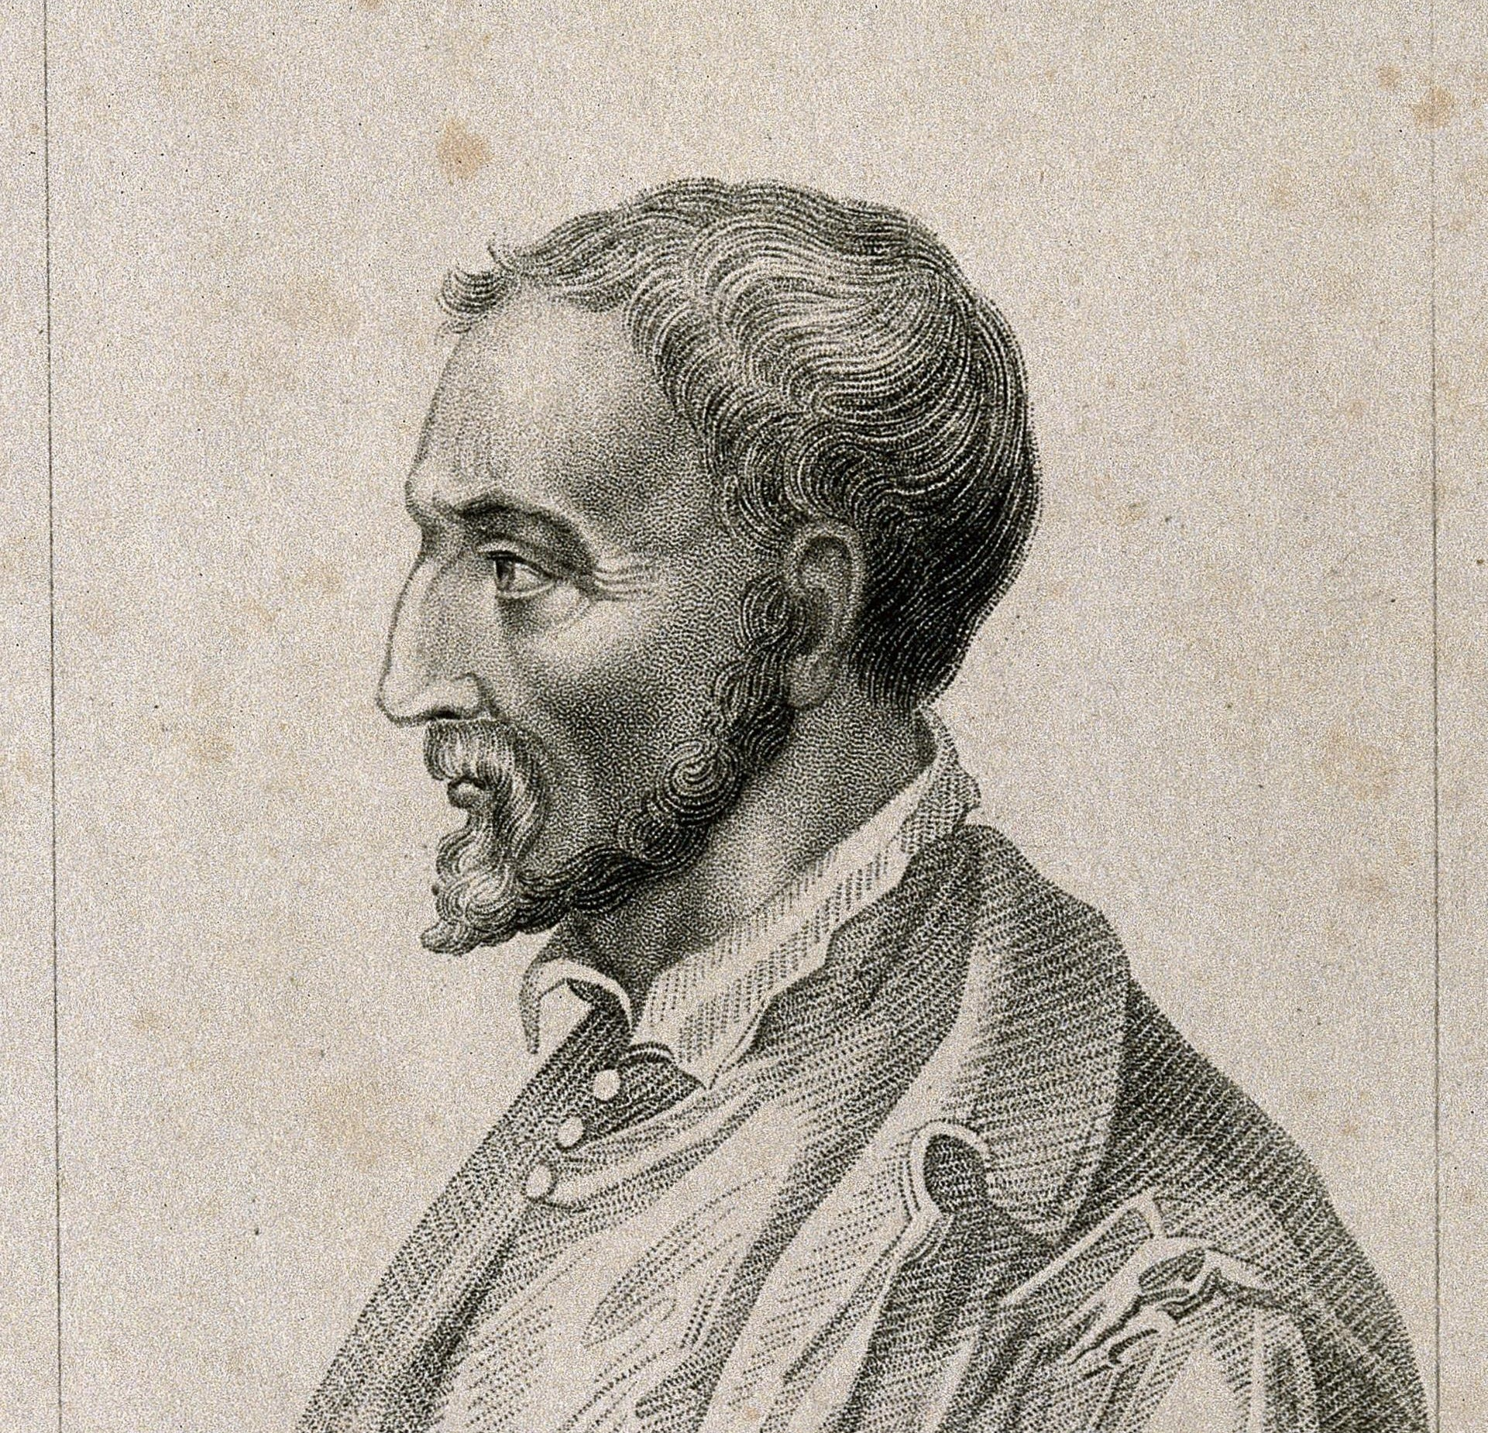

Slide 5
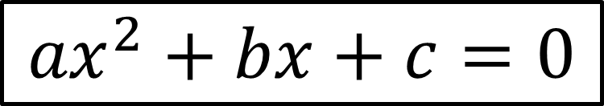
$${ax}^{2}+bx+c=0$$

Slide 6
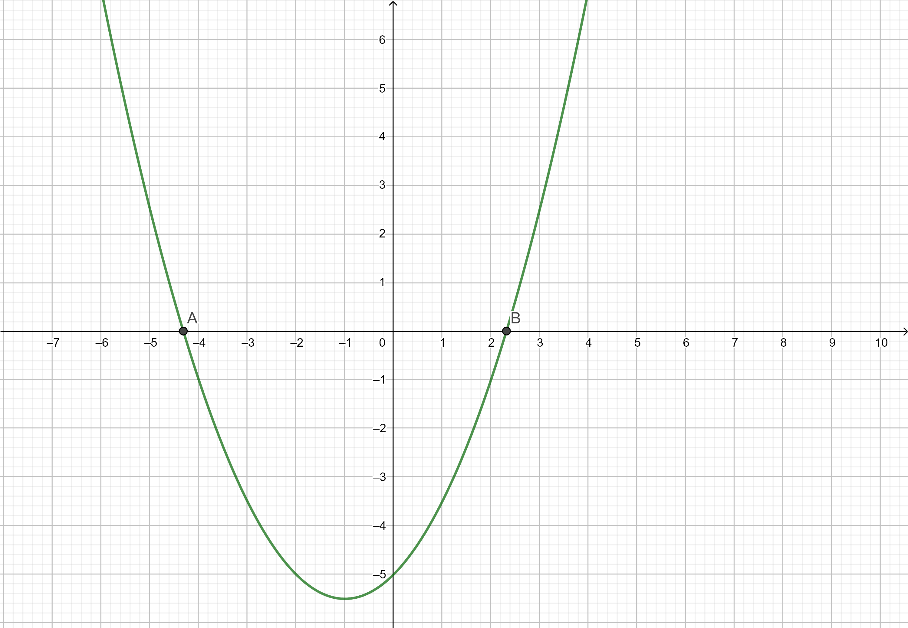
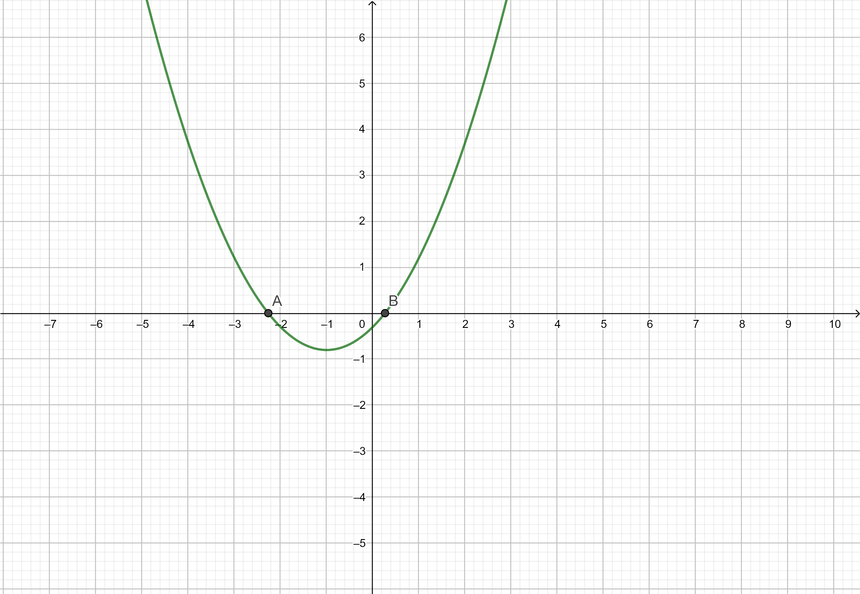
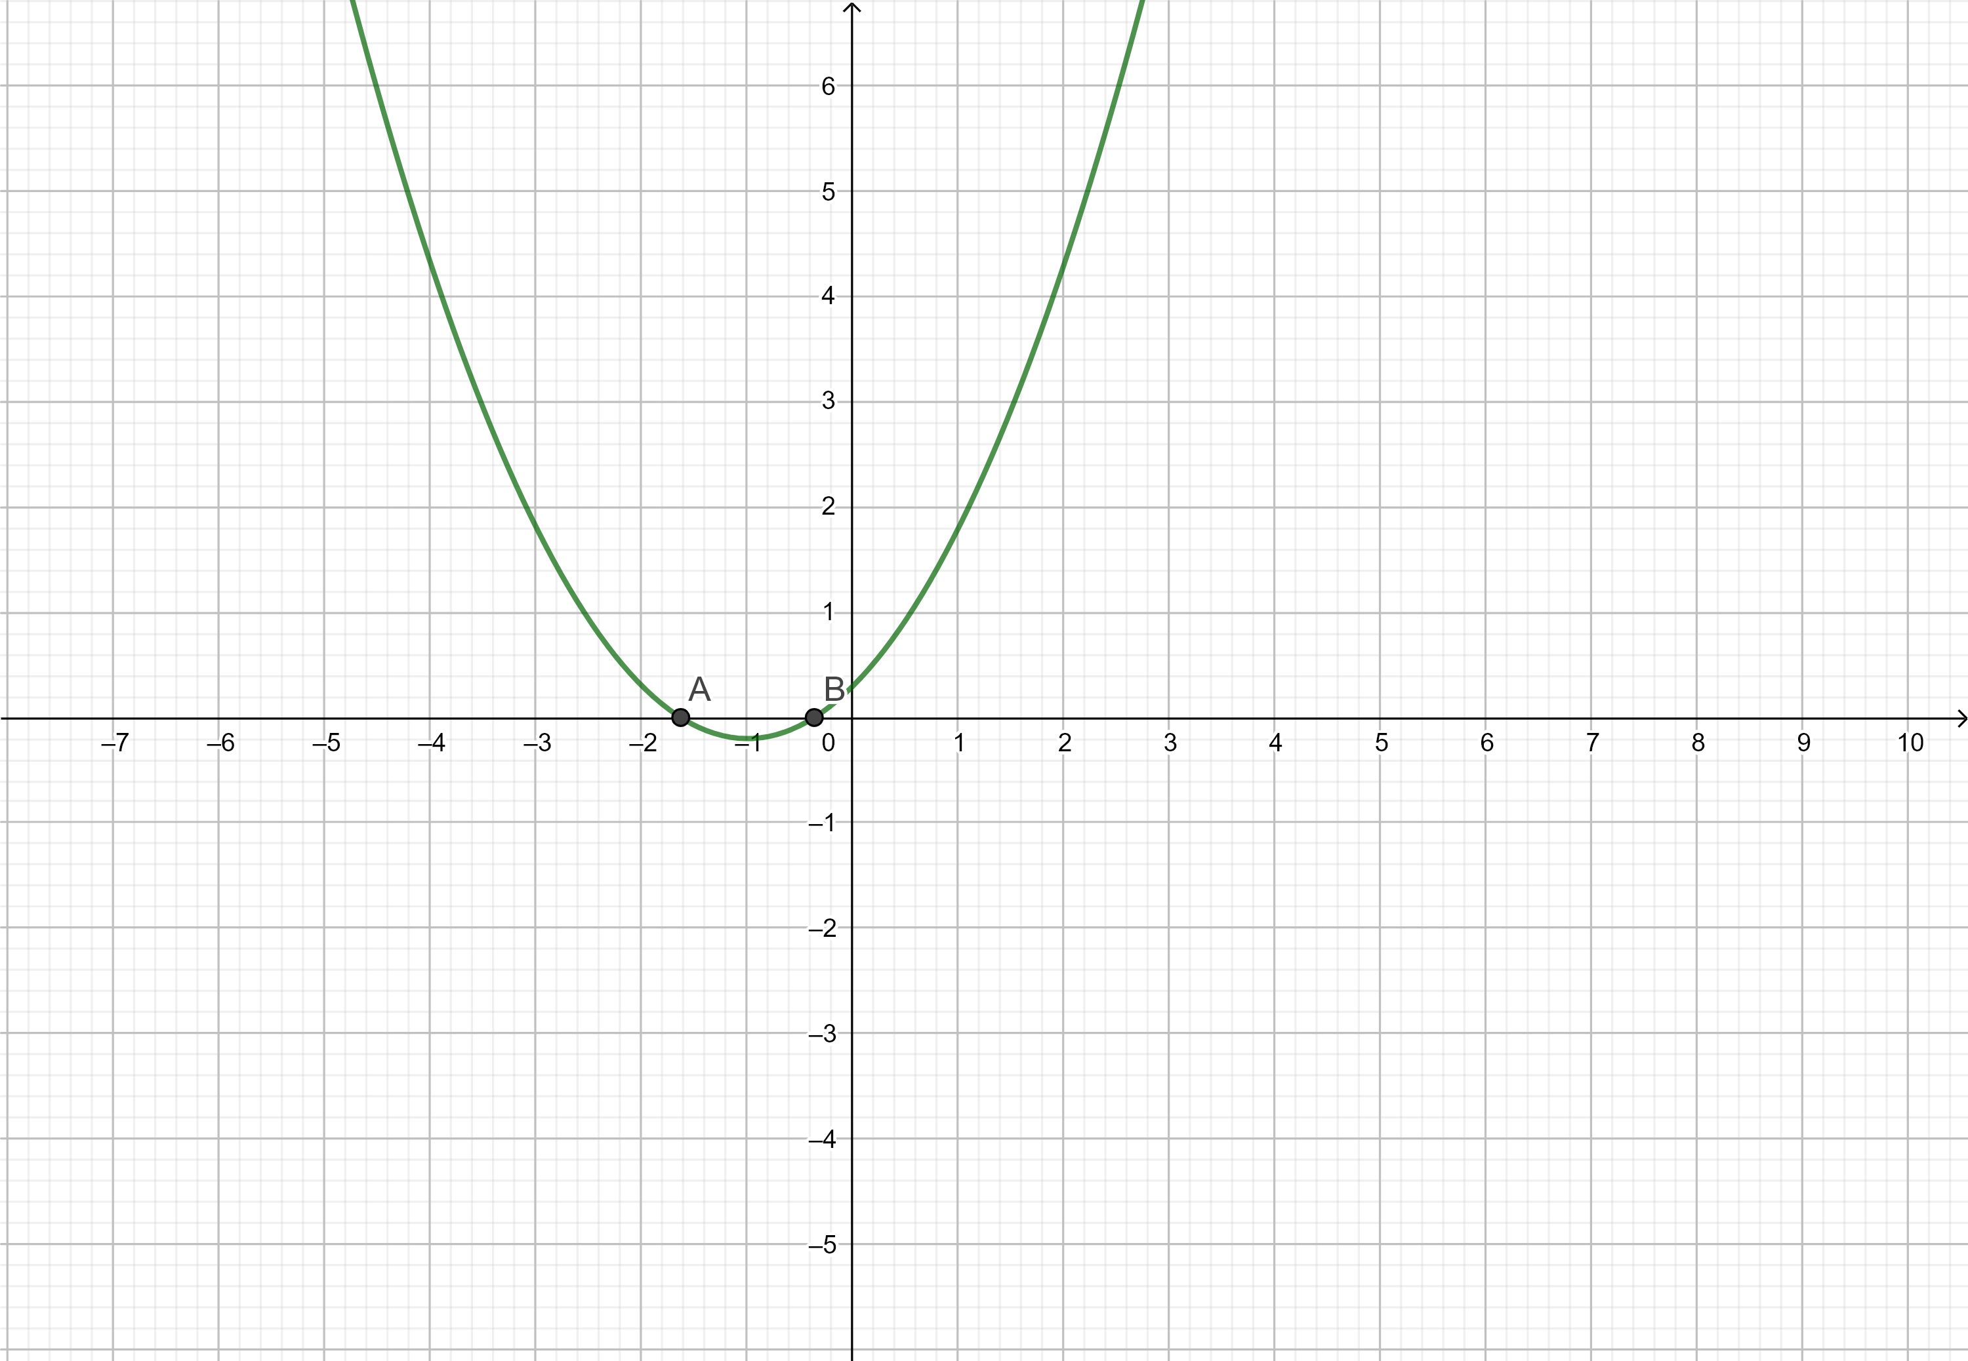
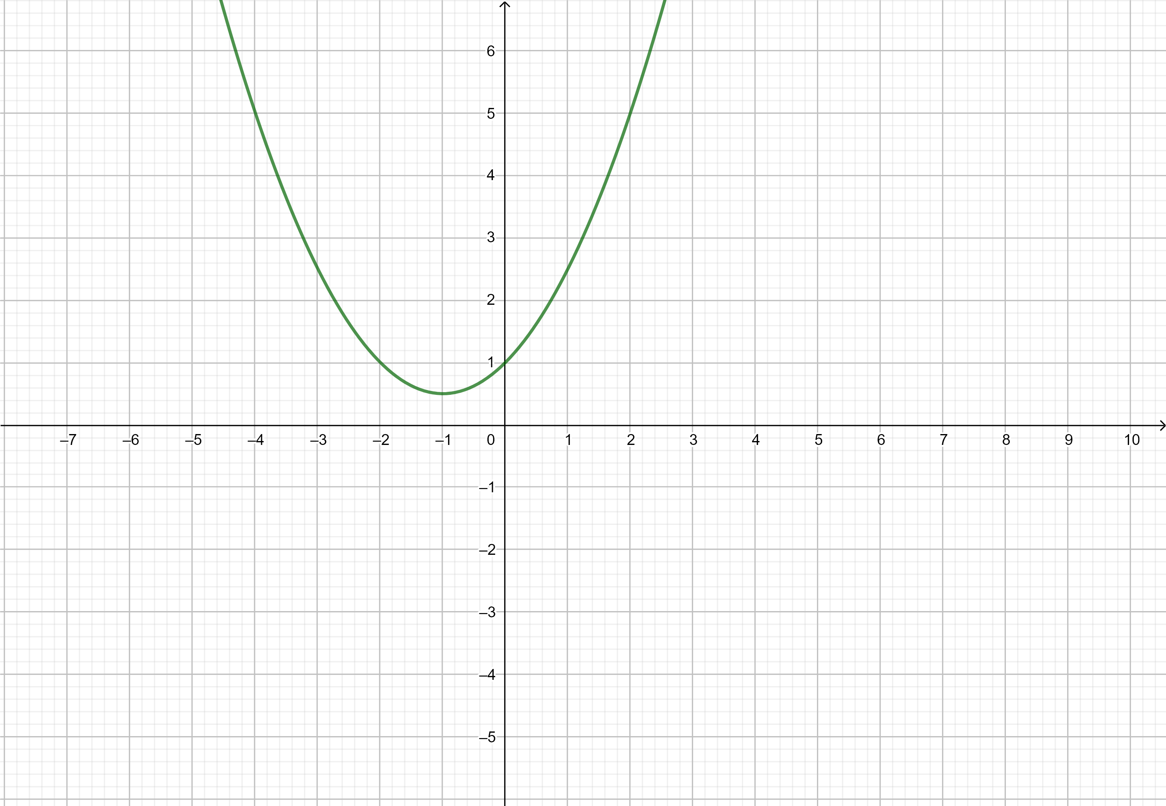
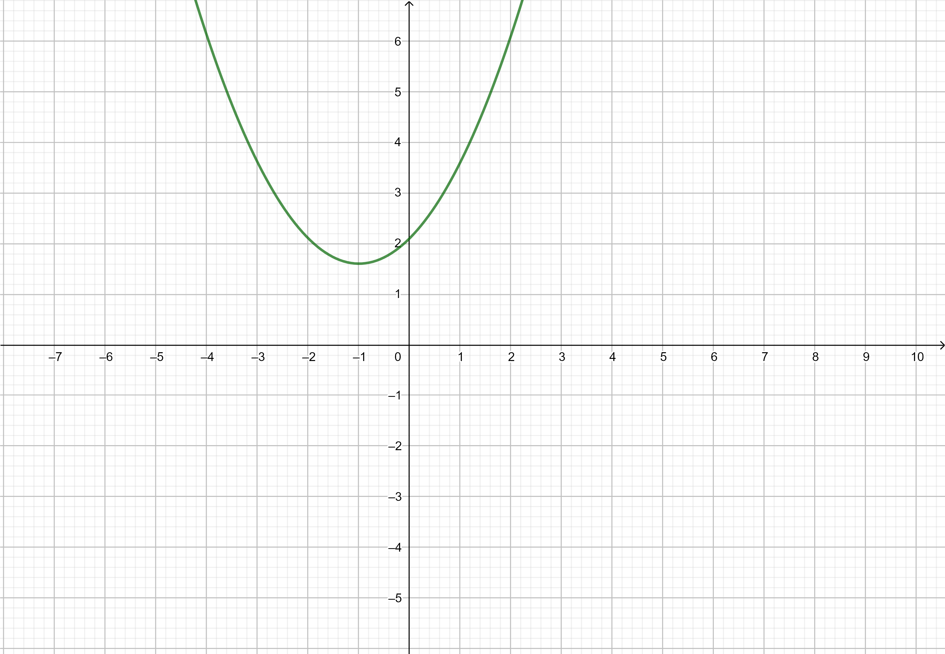
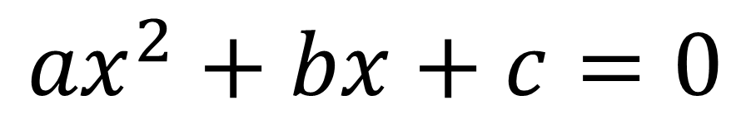
$${ax}^{2}+bx+c=0$$

Slide 7
$${ax}^{2}+bx+c=0$$

Slide 8
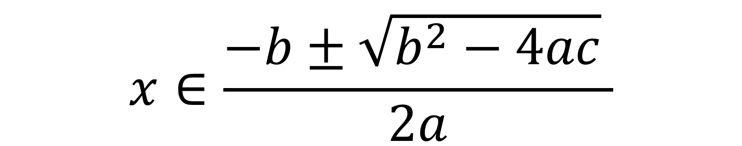
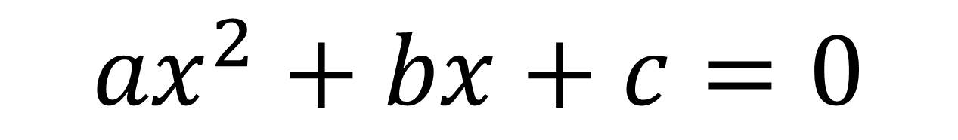
$${ax}^{2}+bx+c=0$$
$$x∈\frac{−b±\sqrt{b^{2}−4ac} }{2a}$$

Slide 9
$${ax}^{2}+bx+c=0$$
$$x∈\frac{−b±\sqrt{b^{2}−4ac} }{2a}$$

Slide 10

$$i=\sqrt{−1}$$

Slide 11

$$i=\sqrt{−1}$$
$$i^{2}=−1$$

Slide 12

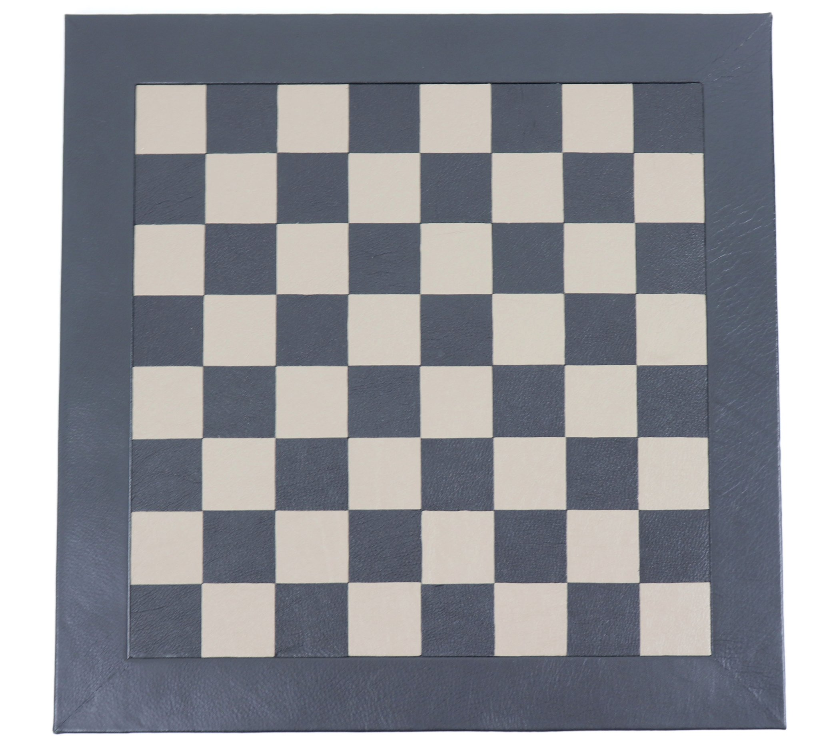
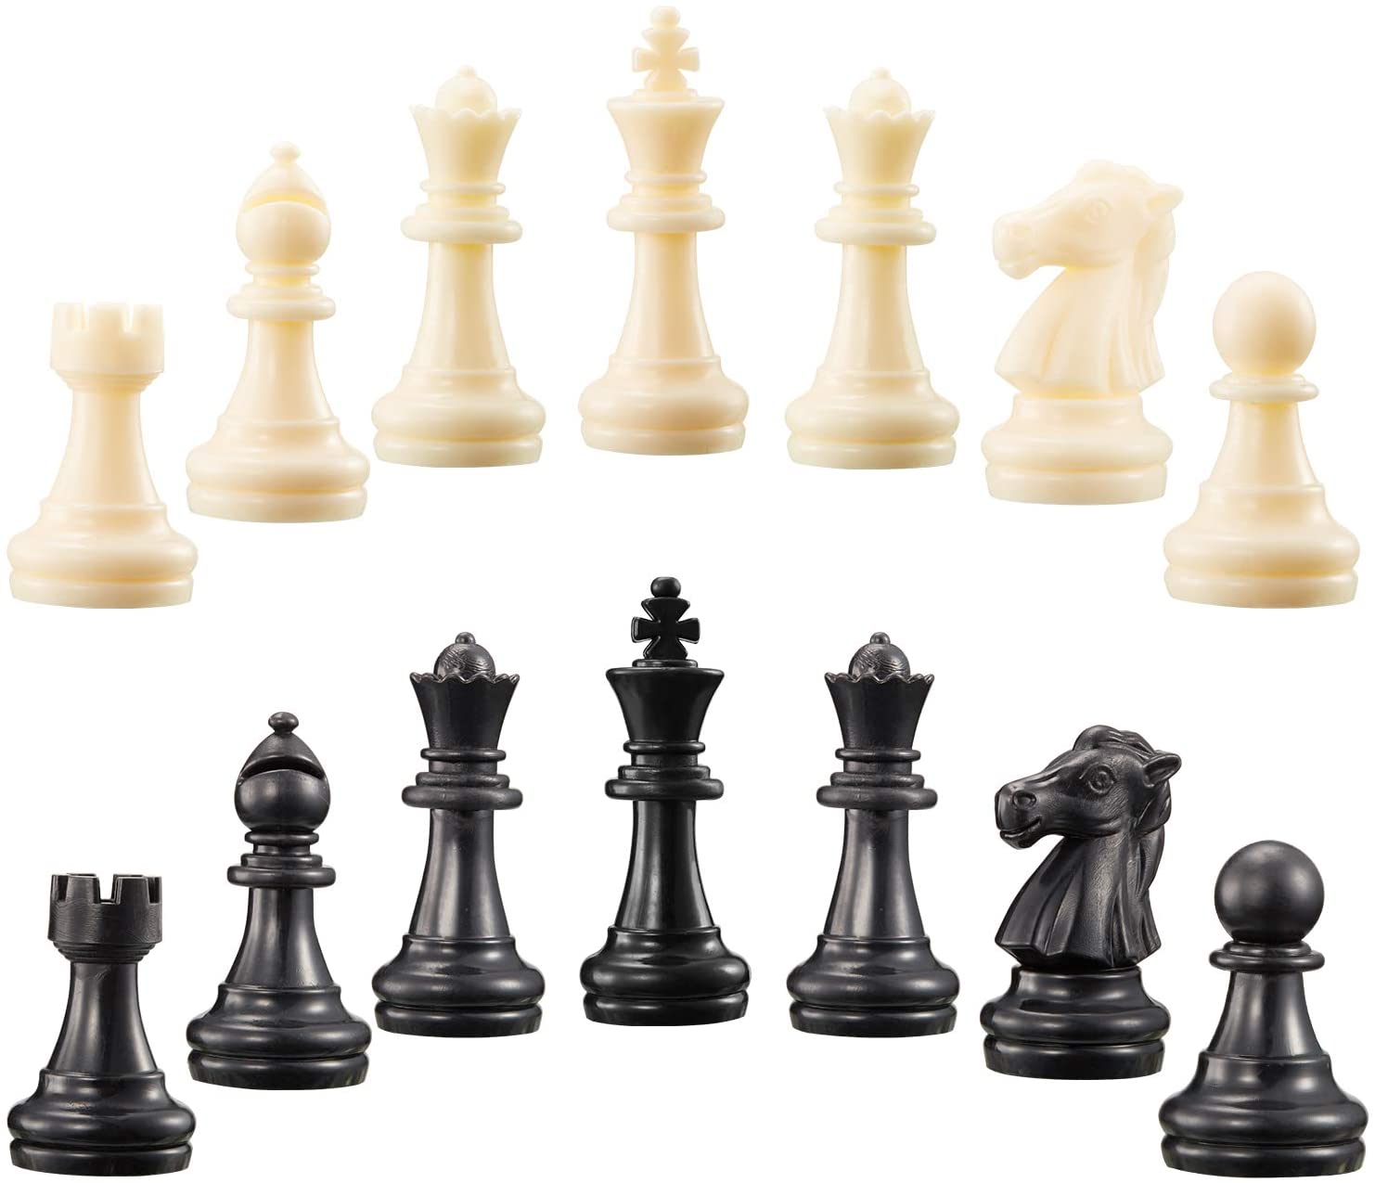

i
+
3/4
π
0
x
/
-2
$$\sqrt{2}$$
1

Slide 13
$$4−3i$$

Slide 14
$$4−3i$$

Slide 15

$${\left(4−3i\right)}^{2}$$
$$=$$
$$4^{2}+{\left(3i\right)}^{2}−2⋅4⋅3i=$$
$$16+9i^{2}−24i=$$
$$16−9−24i=$$
$$7−24i$$

Slide 16
$$f\left(x+iy\right)={\left(x+iy\right)}^{2}$$

Slide 17
$$f\left(x+iy\right)={\left(x+iy\right)}^{2}$$
$$f\left(z\right)=z^{2}$$

Slide 18
$$f\left(x+iy\right)={\left(x+iy\right)}^{2}$$
$$f\left(z\right)=z^{2}$$
$$f\left(z\right)=u\left(x,y\right)+iv(x,y)$$

Slide 19
$$f\left(x+iy\right)={\left(x+iy\right)}^{2}$$
$$f\left(z\right)=z^{2}$$
$$f\left(z\right)=u\left(x,y\right)+iv(x,y)$$
$$f{′\left(z\right)= ?}$$

Slide 20
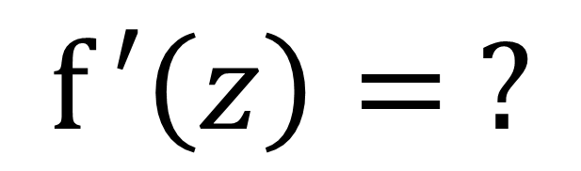
$$f{′\left(z\right)= ?}$$
$$\cos\left(z\right)$$
$$\cos\left(z\right)+e^{z}$$
$$\cos\left(z\right)⋅\log\left(z\right)$$
$$\log\left(z\right)$$
$$\cos\left(e^{z}\right)$$
$$e^{z}$$

Slide 21
Wait a second. Is this useful at all?

Slide 22
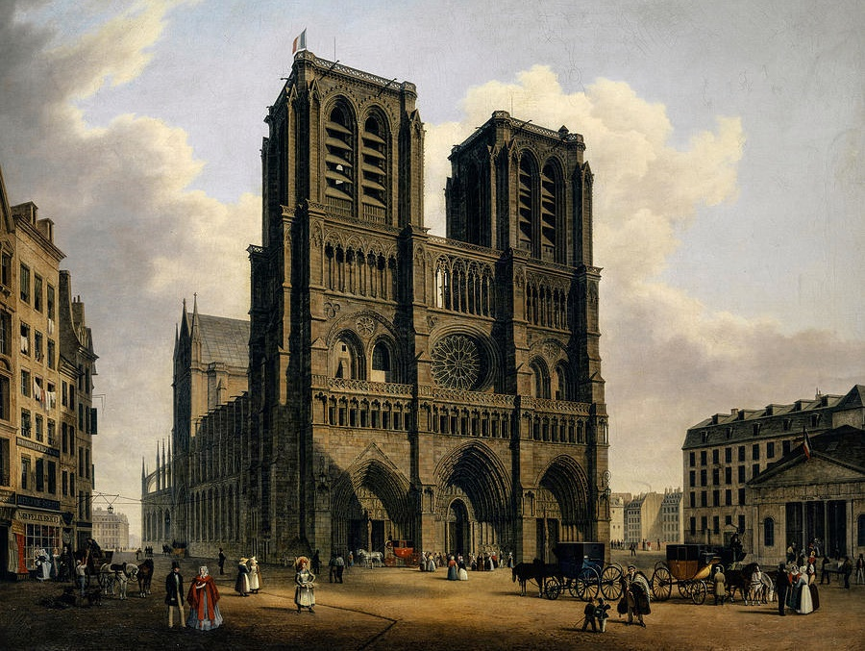
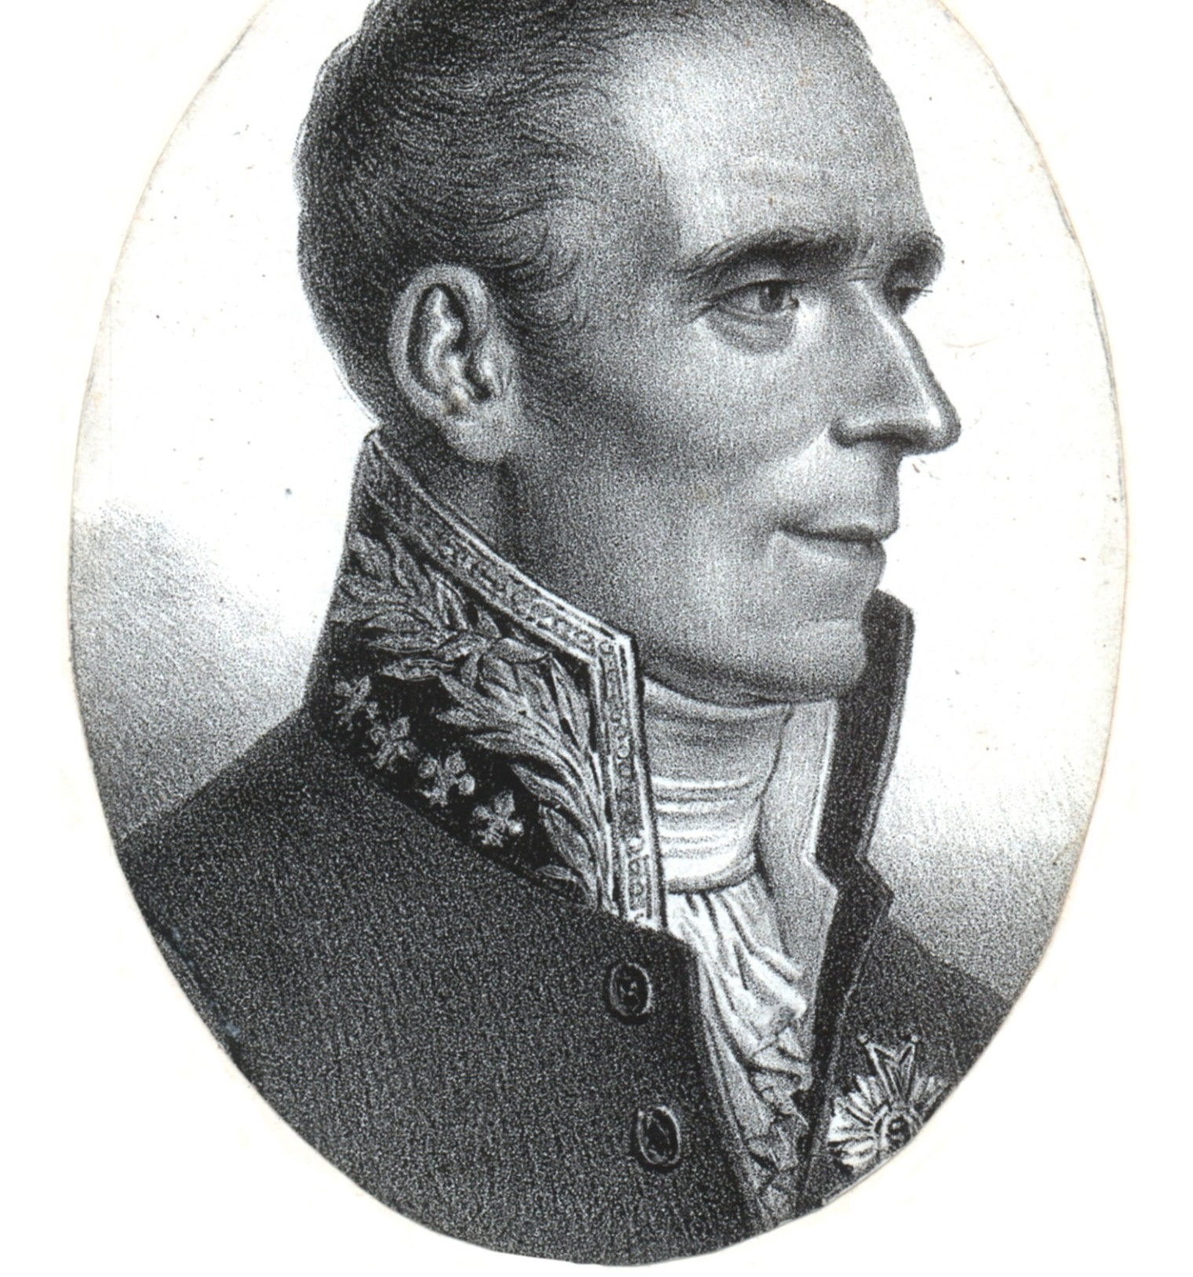

Slide 23
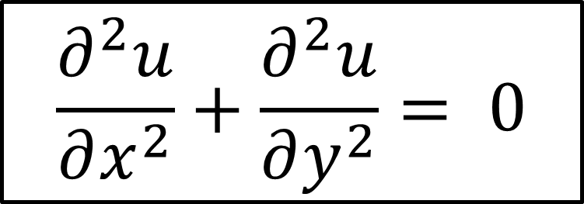
$$\frac{∂^{2}u}{∂x^{2}}+\frac{∂^{2}u}{∂y^{2}}= 0$$

Slide 24
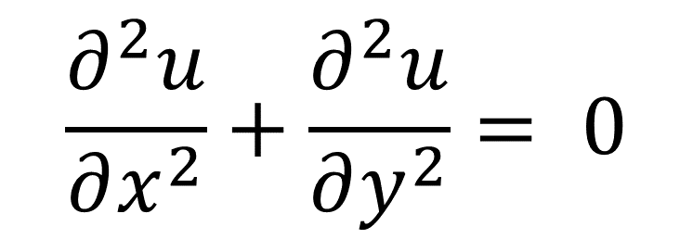
$$\frac{∂^{2}u}{∂x^{2}}+\frac{∂^{2}u}{∂y^{2}}= 0$$
Laplace equation
Electrostatics
Heat transport
Hydrodynamics
Aerodynamics

Slide 25
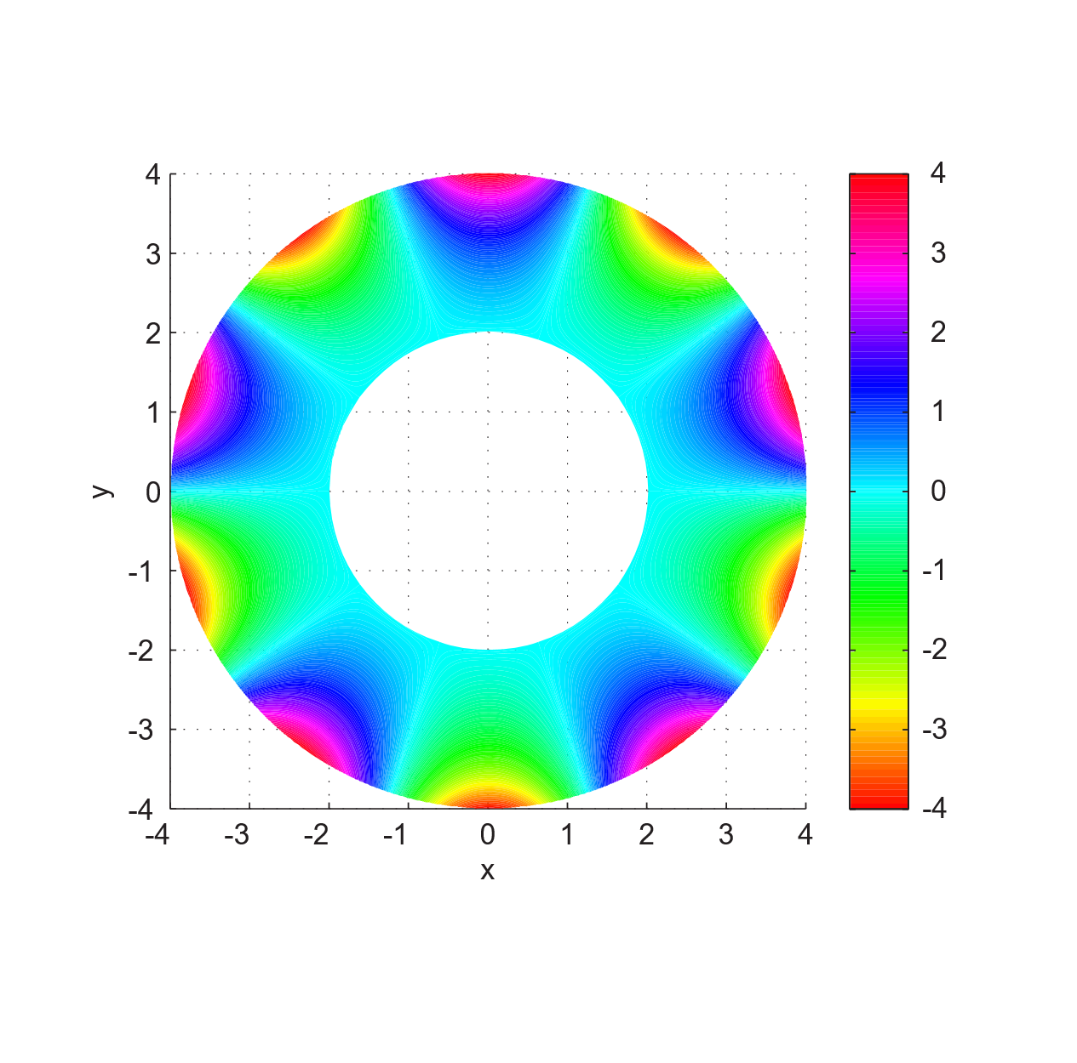
$$\frac{∂^{2}u}{∂x^{2}}+\frac{∂^{2}u}{∂y^{2}}= 0$$

Slide 26
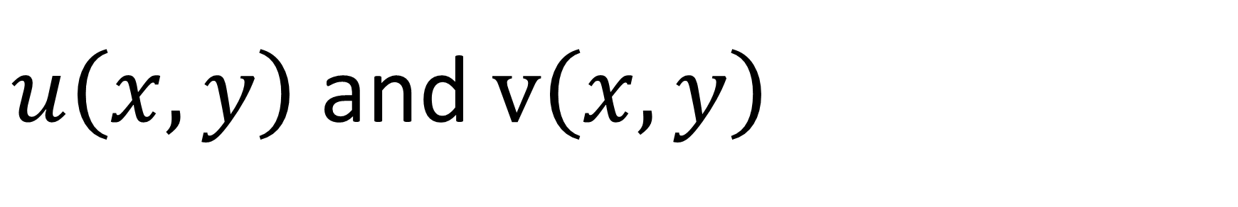
If
$$f\left(z\right)=u\left(x,y\right)+iv(x,y)$$
is differentiable (and most often it is) then:
$u\left(x,y\right)$ and $v\left(x,y\right)$
are solutions of Laplace’s equation

Slide 27
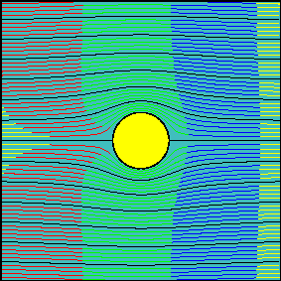
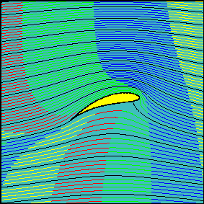
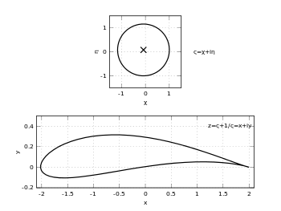

Slide 28
If
$$f\left(z\right)=u\left(x,y\right)+iv(x,y)$$
is differentiable (and most often it is) then:
$u\left(x,y\right)$ and $v\left(x,y\right)$
are solutions of Laplace’s equation
Bonus: their contour lines are perpendicular

Slide 29
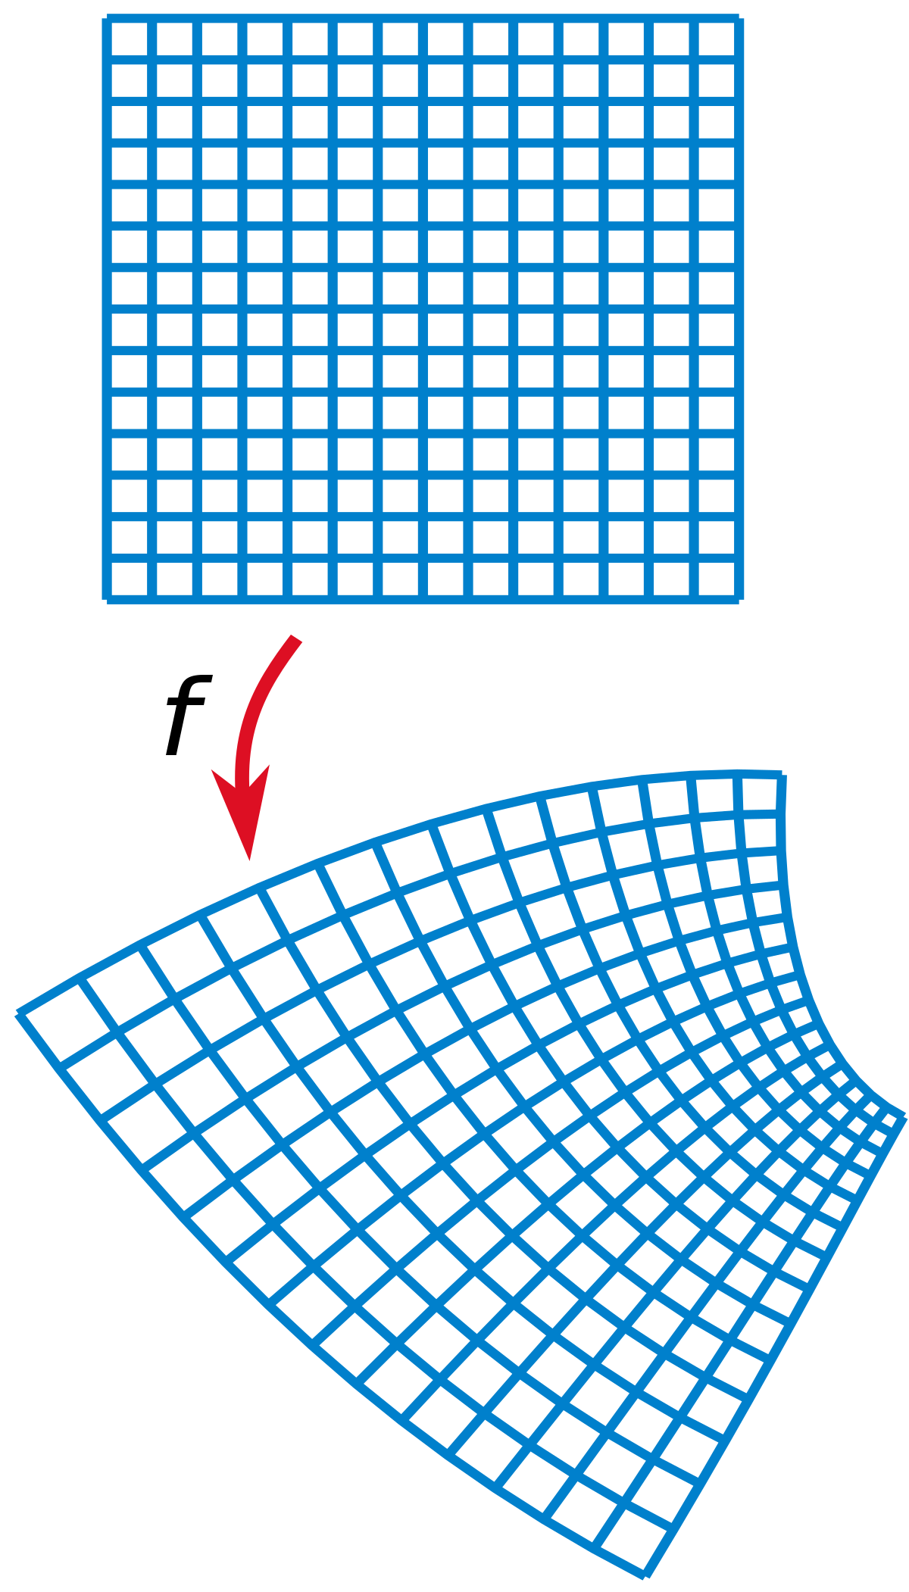

Slide 30
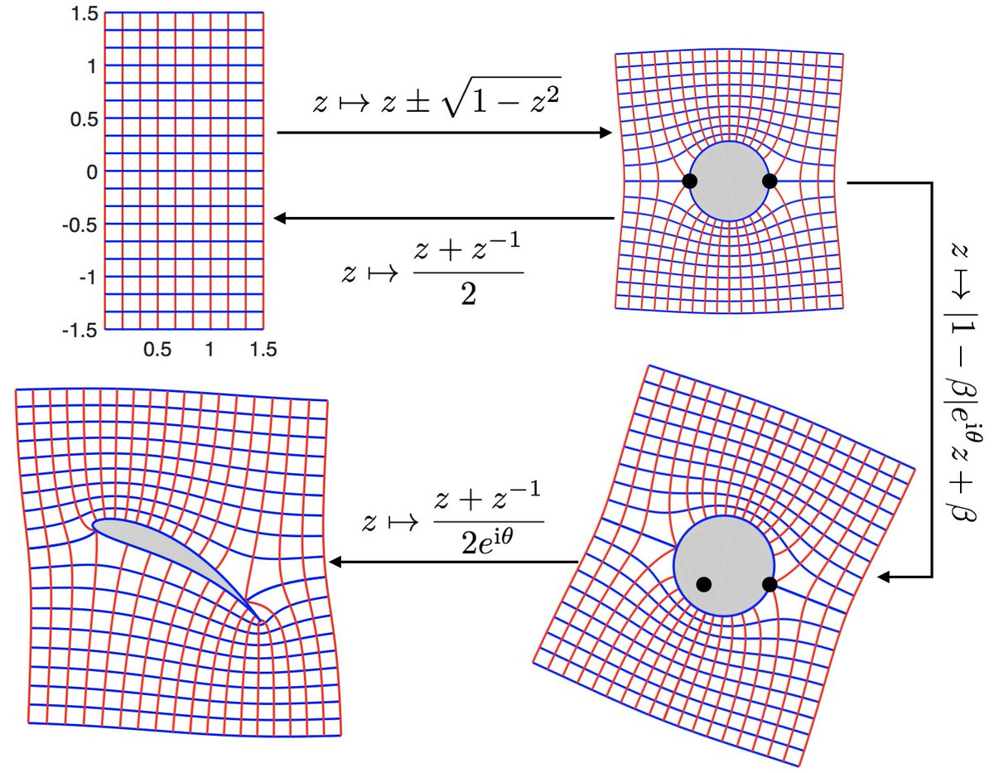

Slide 31
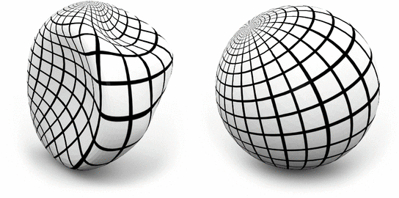

Slide 32
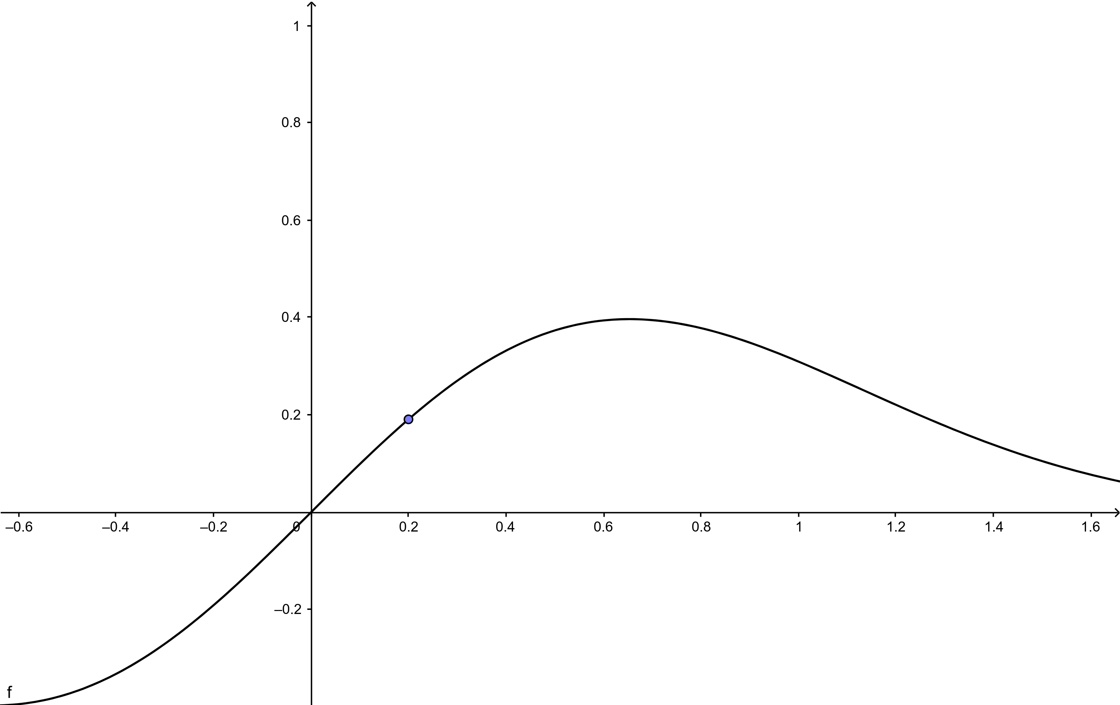
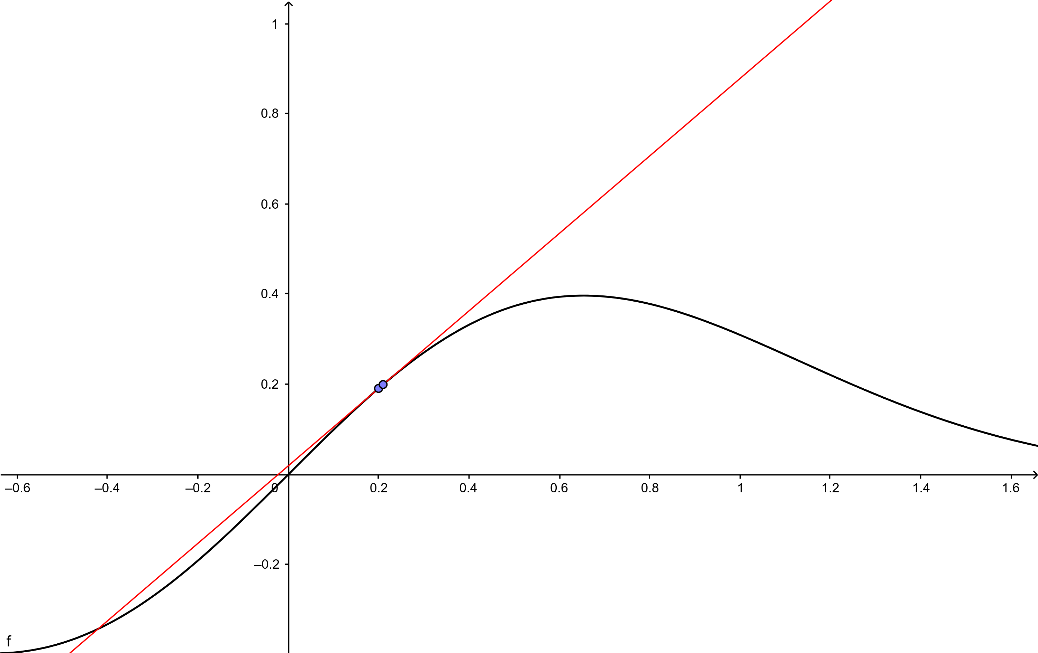
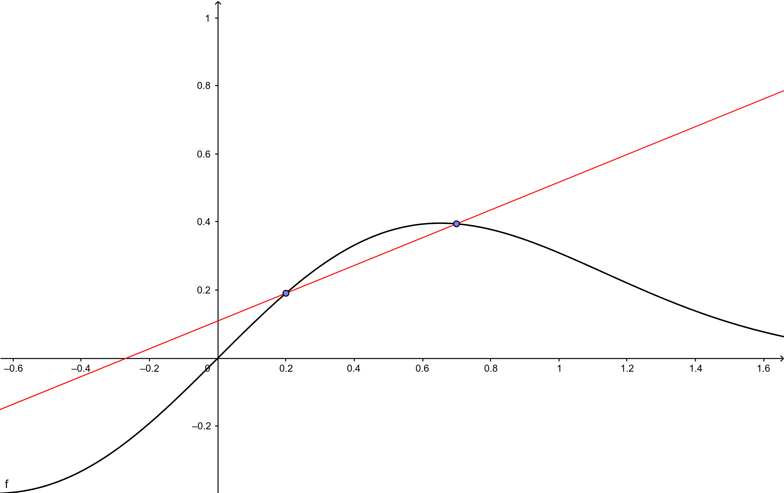
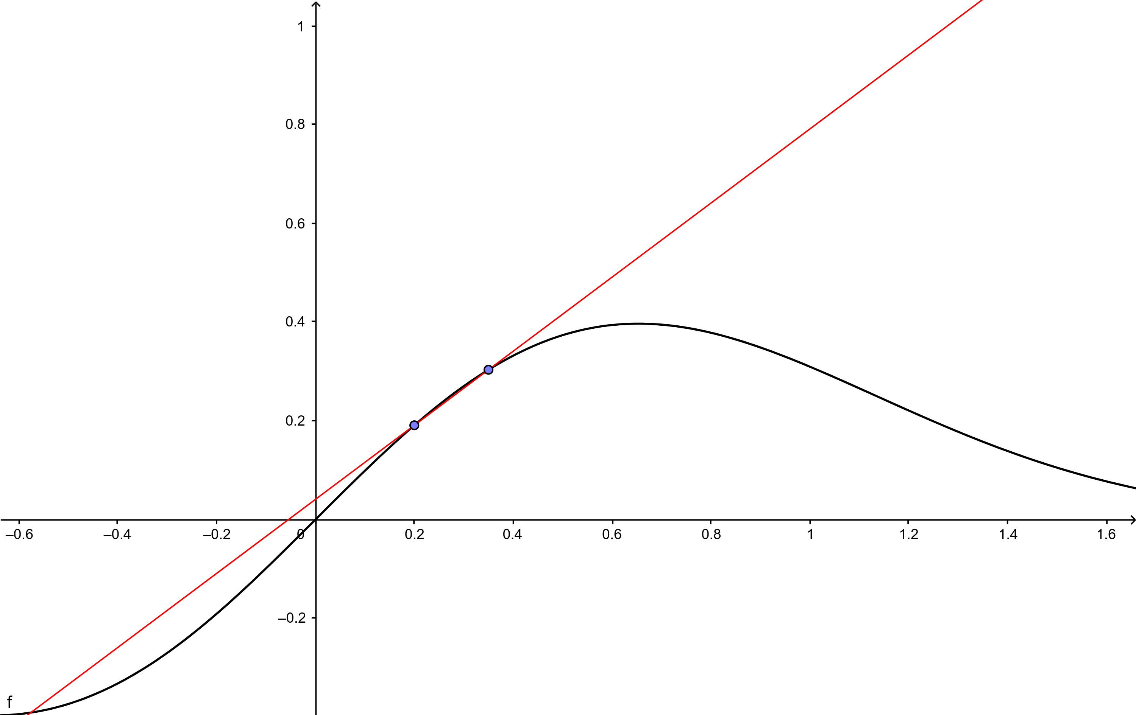
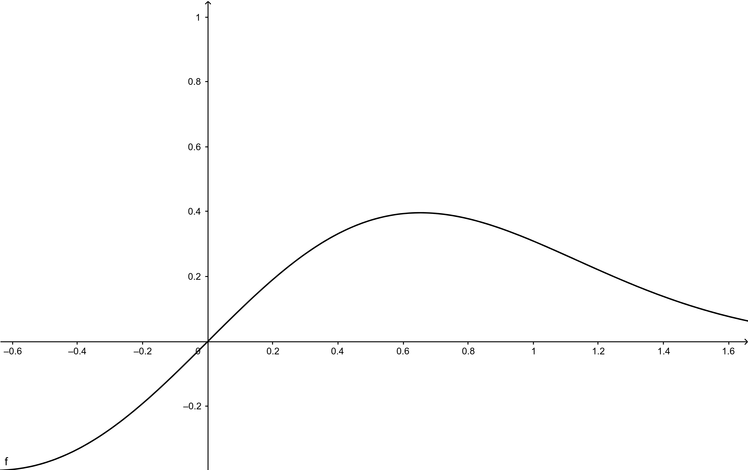

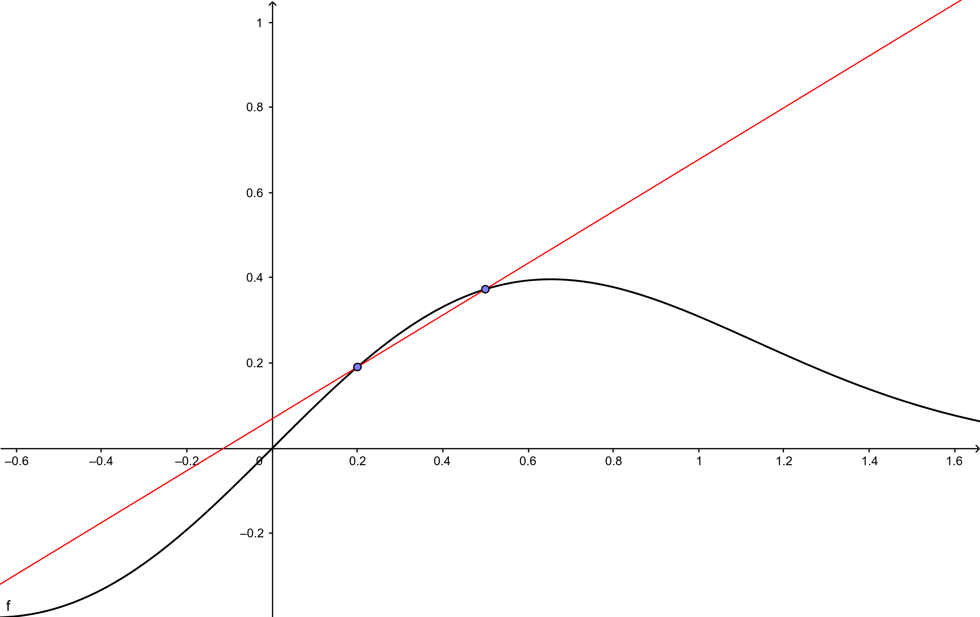
Numerical differentiation in a nutshell

Slide 33
Numerical differentiation in a nutshell
$$f\left(x_{0}+ε\right)≈a_{0}+a_{1}ε+a_{2}ε^{2}+ …$$

Slide 34
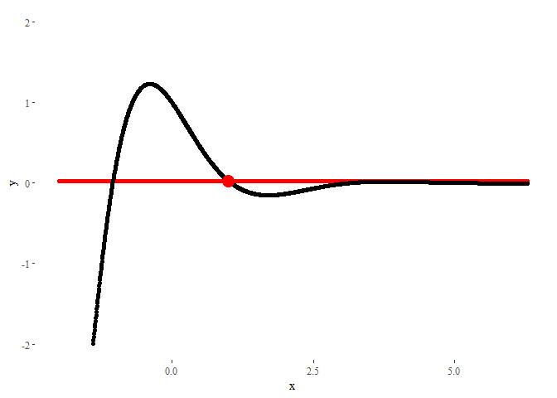
Numerical differentiation in a nutshell
$$f\left(x_{0}+ε\right)≈a_{0}+a_{1}ε+a_{2}ε^{2}+ …$$

Slide 35
Numerical differentiation in a nutshell
$$f\left(x_{0}+ε\right)≈a_{0}+a_{1}ε+a_{2}ε^{2}+O(ε^{3})$$

Slide 36
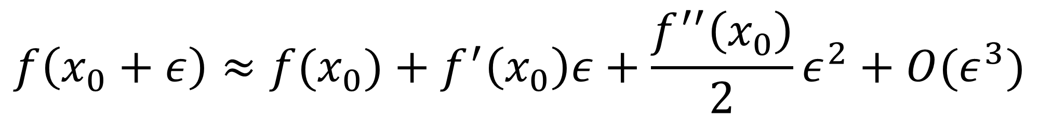
Numerical differentiation in a nutshell
$$f\left(x_{0}+ε\right)≈a_{0}+a_{1}ε+a_{2}ε^{2}+O(ε^{3})$$
$$f\left(x_{0}+ε\right)≈f(x_{0})+f^{′}\left(x_{0}\right)ε+\frac{f^{′′}\left(x_{0}\right)}{2}ε^{2}+O(ε^{3})$$

Slide 37
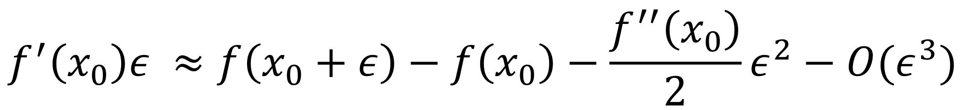
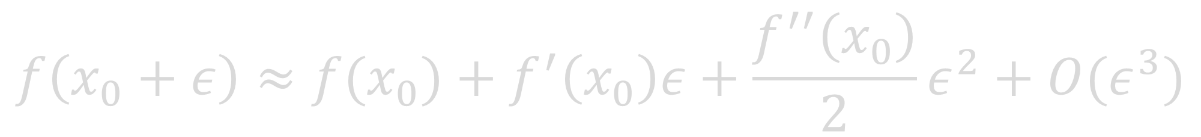
Numerical differentiation in a nutshell
$$f\left(x_{0}+ε\right)≈a_{0}+a_{1}ε+a_{2}ε^{2}+O(ε^{3})$$
$$f\left(x_{0}+ε\right)≈f(x_{0})+f^{′}\left(x_{0}\right)ε+\frac{f^{′′}\left(x_{0}\right)}{2}ε^{2}+O(ε^{3})$$
$$f^{′}\left(x_{0}\right)ε ≈f\left(x_{0}+ε\right)−f\left(x_{0}\right)−\frac{f^{′′}\left(x_{0}\right)}{2}ε^{2}−O(ε^{3})$$

Slide 38
Numerical differentiation in a nutshell
$$f\left(x_{0}+ε\right)≈a_{0}+a_{1}ε+a_{2}ε^{2}+O(ε^{3})$$
$$f\left(x_{0}+ε\right)≈f(x_{0})+f^{′}\left(x_{0}\right)ε+\frac{f^{′′}\left(x_{0}\right)}{2}ε^{2}+O(ε^{3})$$
$$f^{′}\left(x_{0}\right)ε ≈f\left(x_{0}+ε\right)−f\left(x_{0}\right)−\frac{f^{′′}\left(x_{0}\right)}{2}ε^{2}−O(ε^{3})$$

Slide 39

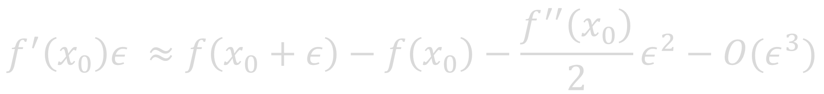
Numerical differentiation in a nutshell
$$f\left(x_{0}+ε\right)≈a_{0}+a_{1}ε+a_{2}ε^{2}+O(ε^{3})$$
$$f\left(x_{0}+ε\right)≈f(x_{0})+f^{′}\left(x_{0}\right)ε+\frac{f^{′′}\left(x_{0}\right)}{2}ε^{2}+O(ε^{3})$$
$$f^{′}\left(x_{0}\right)ε ≈f\left(x_{0}+ε\right)−f\left(x_{0}\right)−\frac{f^{′′}\left(x_{0}\right)}{2}ε^{2}−O(ε^{3})$$
$$f^{′}\left(x_{0}\right) ≈\frac{f\left(x_{0}+ε\right)−f\left(x_{0}\right)}{ε}+O(ϵ)$$

Slide 40
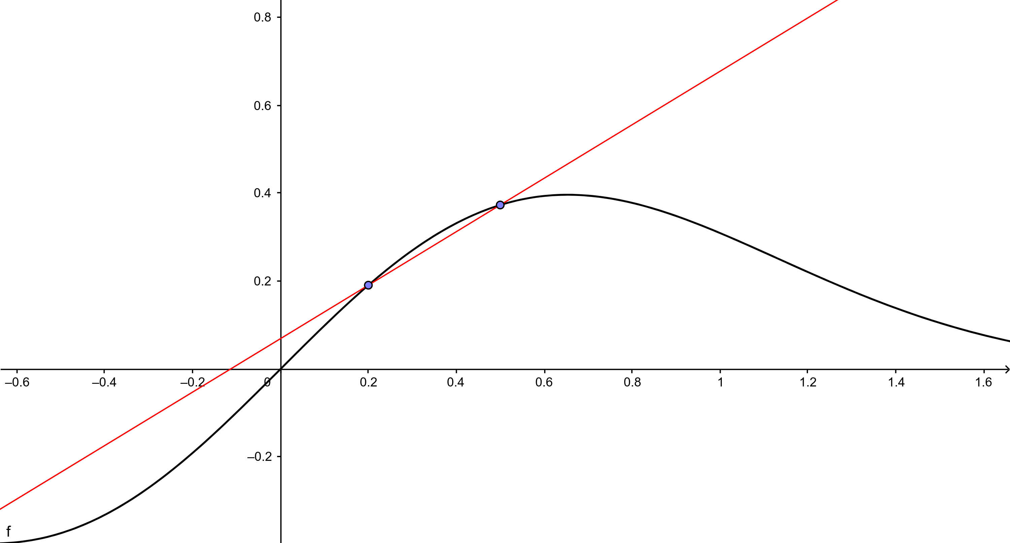
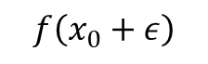
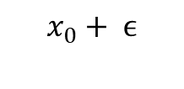
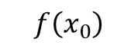
Numerical differentiation in a nutshell
$$f\left(x_{0}+ε\right)$$
$$f\left(x_{0}\right)$$
$$x_{0}$$
$$x_{0}+ ϵ$$
$$f^{′}\left(x_{0}\right) ≈\frac{f\left(x_{0}+ε\right)−f\left(x_{0}\right)}{ε}+O(ϵ)$$

Slide 41
Complex step differentiation in a nutshell
$$f\left(x_{0}+iε\right)≈a_{0}+{ia}_{1}ε−a_{2}ε^{2}+iO(ε^{3})$$

Slide 42
Complex step differentiation in a nutshell
$$f\left(x_{0}+iε\right)≈a_{0}+{ia}_{1}ε−a_{2}ε^{2}+iO(ε^{3})$$
$$f\left(x_{0}+iε\right)≈f\left(x_{0}\right)+{if}^{′}\left(x_{0}\right)ε−\frac{f^{′′}\left(x_{0}\right)}{2}ε^{2}+iO(ε^{3})$$

Slide 43
Complex step differentiation in a nutshell
$$f\left(x_{0}+iε\right)≈a_{0}+{ia}_{1}ε−a_{2}ε^{2}+iO(ε^{3})$$
$$f\left(x_{0}+iε\right)≈f\left(x_{0}\right)+{if}^{′}\left(x_{0}\right)ε−\frac{f^{′′}\left(x_{0}\right)}{2}ε^{2}+iO(ε^{3})$$
$$ℑ\{f\left(x_{0}+iε\right)\}≈f′\left(x_{0}\right)ε+O(ε^{3})$$

Slide 44

Complex step differentiation in a nutshell
$$f\left(x_{0}+iε\right)≈a_{0}+{ia}_{1}ε−a_{2}ε^{2}+iO(ε^{3})$$
$$f\left(x_{0}+iε\right)≈f\left(x_{0}\right)+{if}^{′}\left(x_{0}\right)ε−\frac{f^{′′}\left(x_{0}\right)}{2}ε^{2}+iO(ε^{3})$$
$$ℑ\{f\left(x_{0}+iε\right)\}≈f′\left(x_{0}\right)ε+O(ε^{3})$$
$$f^{′}\left(x_{0}\right) ≈\frac{ℑ \left\{f\left(x_{0}+iε\right)\right\}}{ε}+O(ϵ^{2})$$

Slide 45
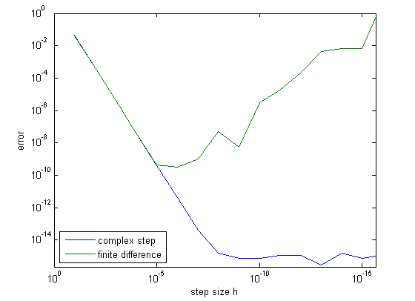
Complex step differentiation in a nutshell
$$f^{′}\left(x_{0}\right) ≈\frac{ℑ \left\{f\left(x_{0}+iε\right)\right\}}{ε}+O(ϵ^{2})$$

Slide 46
$$i^{2}=−1$$

Slide 47
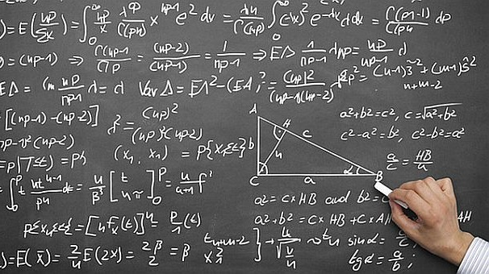

Slide 48

Thanks for your attention
Slides available at
pabrod.github.io

